Slide 1
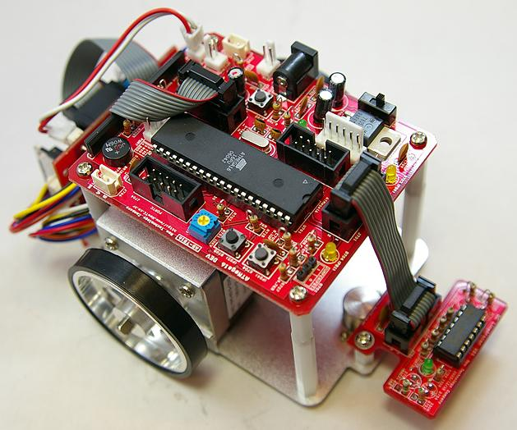
3D Reconstruction by Using Ultrasonic Sensors
07 CS Dept Jeong Hoe Hyeon

Slide 2
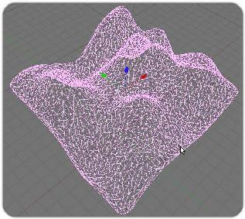
The goal of the project
A creation of 3D space surrounding by using ultra sonic

Slide 3
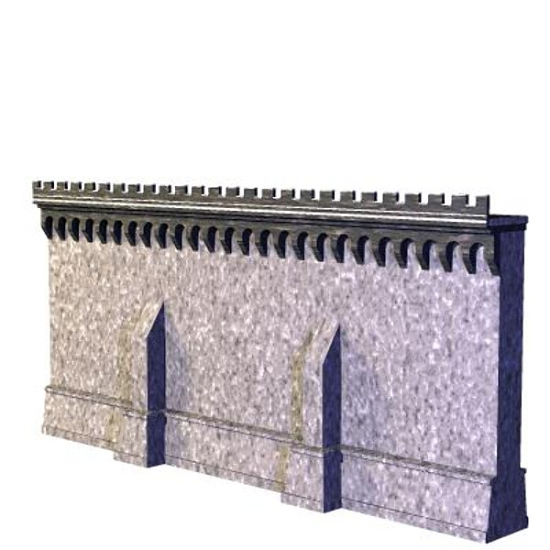
The goal of the project
Motor car’s navigation based on created 3D space

Slide 4
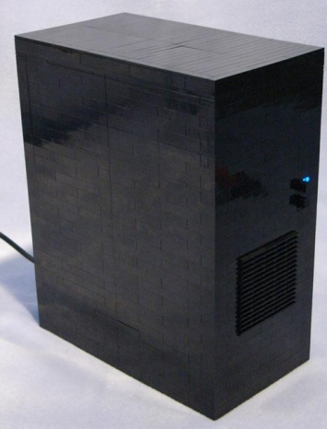

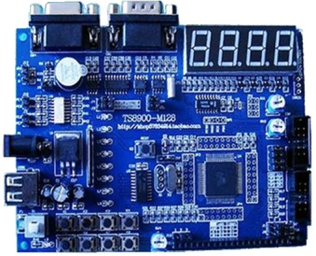
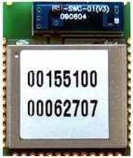

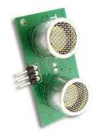
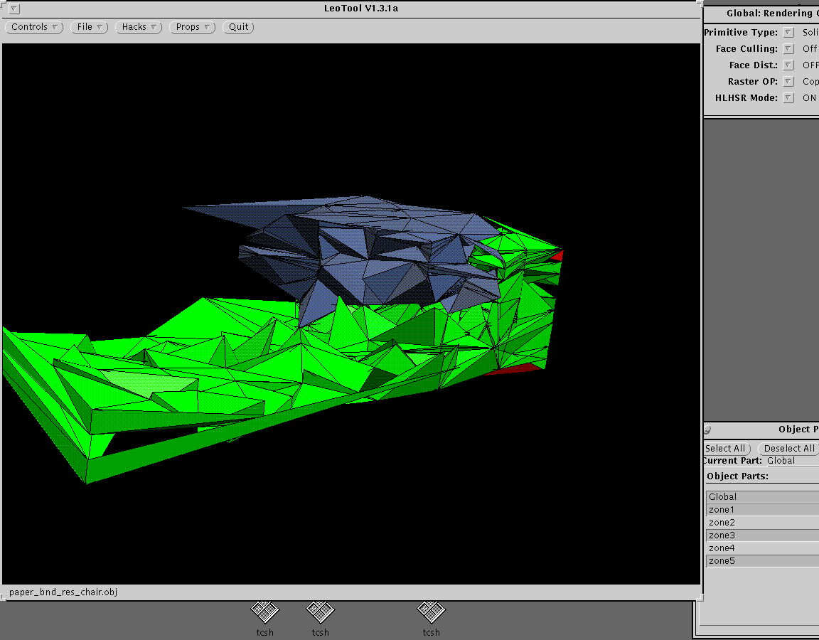
System Design
Bluetooth module
Bluetooth module
Mortor car
Ultrasonic sesnsor
Gravitational Acceleration sensor
PC
3D environment Reconstruction
Navigation based on Reconstructed 3D space
Application

Slide 5
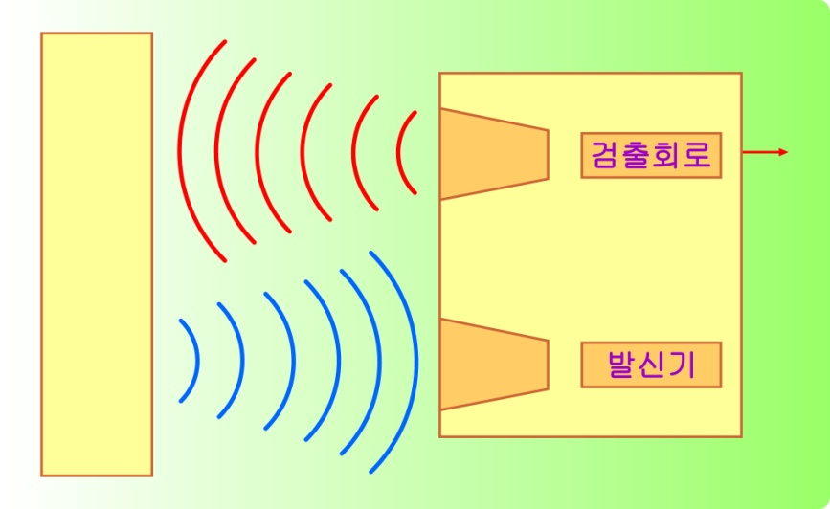
The process of 3D reconstruction using ultrasonic
human can’t sense 14KHZ over
calculate the reflection time between sensor and obstacle
- Velocity in air V[m/s]=331.5+0.6t
(t is a temperature)
distance = time x velocity
Distance to obstacle
D = t/2 * v[m/s] (time*velocity)

Slide 6
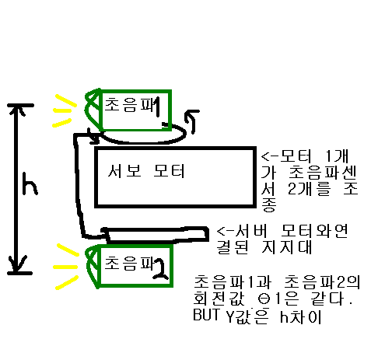
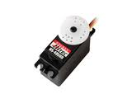
The process of 3D reconstruction using ultrasonic
To reconstruct 3D space, at least, two ultrasonic sensor is needed
Fixed the number of coordinate of Y axis to two
every 3D coordinates ∈ (x, Y1, z)
∈ (x, Y2, z)
.

Slide 7
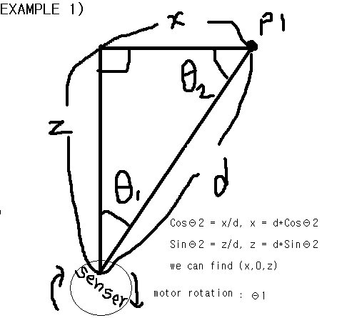
The process of 3D reconstruction using ultrasonic
Calculating 3D coordinates in real world
We can get this by
trigonometrical function
P(x,y,z)

Slide 8
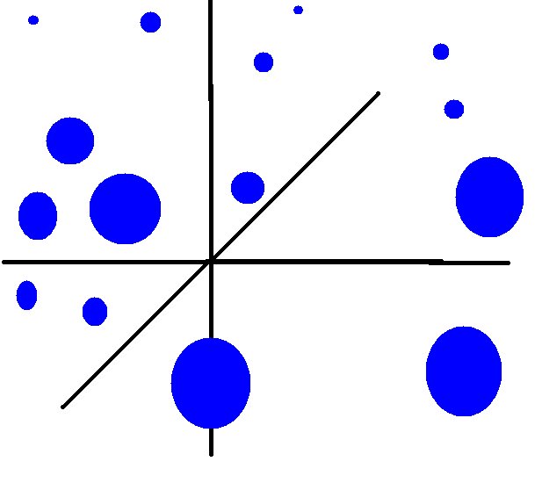
The process of 3D reconstruction using ultrasonic
Transmit 3D coordinates to PC

Slide 9
The process of 3D reconstruction using ultrasonic
20times Sensing from left to right

Slide 10
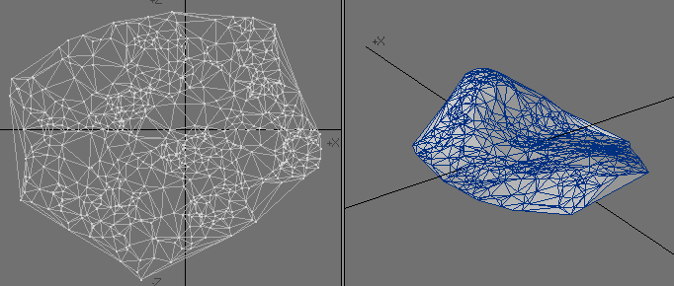
The process of 3D reconstruction using ultrasonic
Implementing on PC using OpenGL

Slide 11
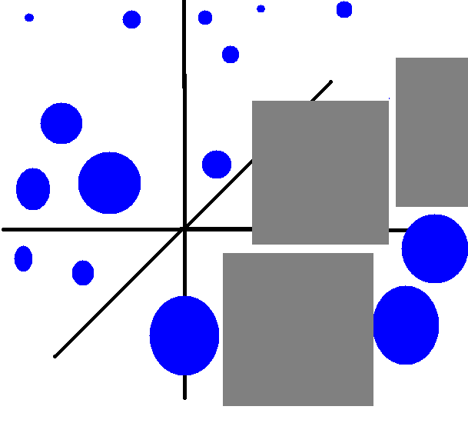
Calculating navigation in 3D space
Navigation after searching route

Slide 12
H/W implementing
Measuringa distance using time difference between sending signal and receiving siganl
Zigbee bluetooth module
Just Connecting Power and in/out port is all, easy
Two mode of moving motor car
Auto mode : User don’t involve in moving motor car with navigation after making 3d space
Manual mode : User invovles in moving motor car with Gravitational Acceleration sensor not navigation after making 3d space

Slide 13
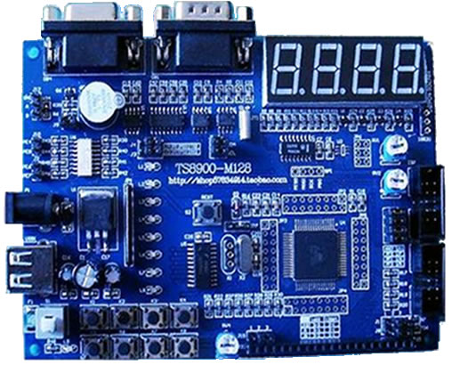
H/W implementing
Board connecting with PC
(Control Motor car, bluetooth)
Using Atmega 128 MCU
Board for motor car (motors, ultrasonic, bluetooth)
Using Atmega 16 MCU

Slide 14
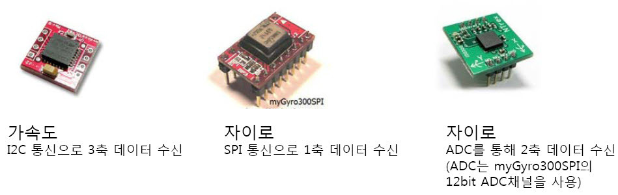
H/W & S/W implementing
Application Implementing
C#
OpenGL
Real time rendering

Slide 15
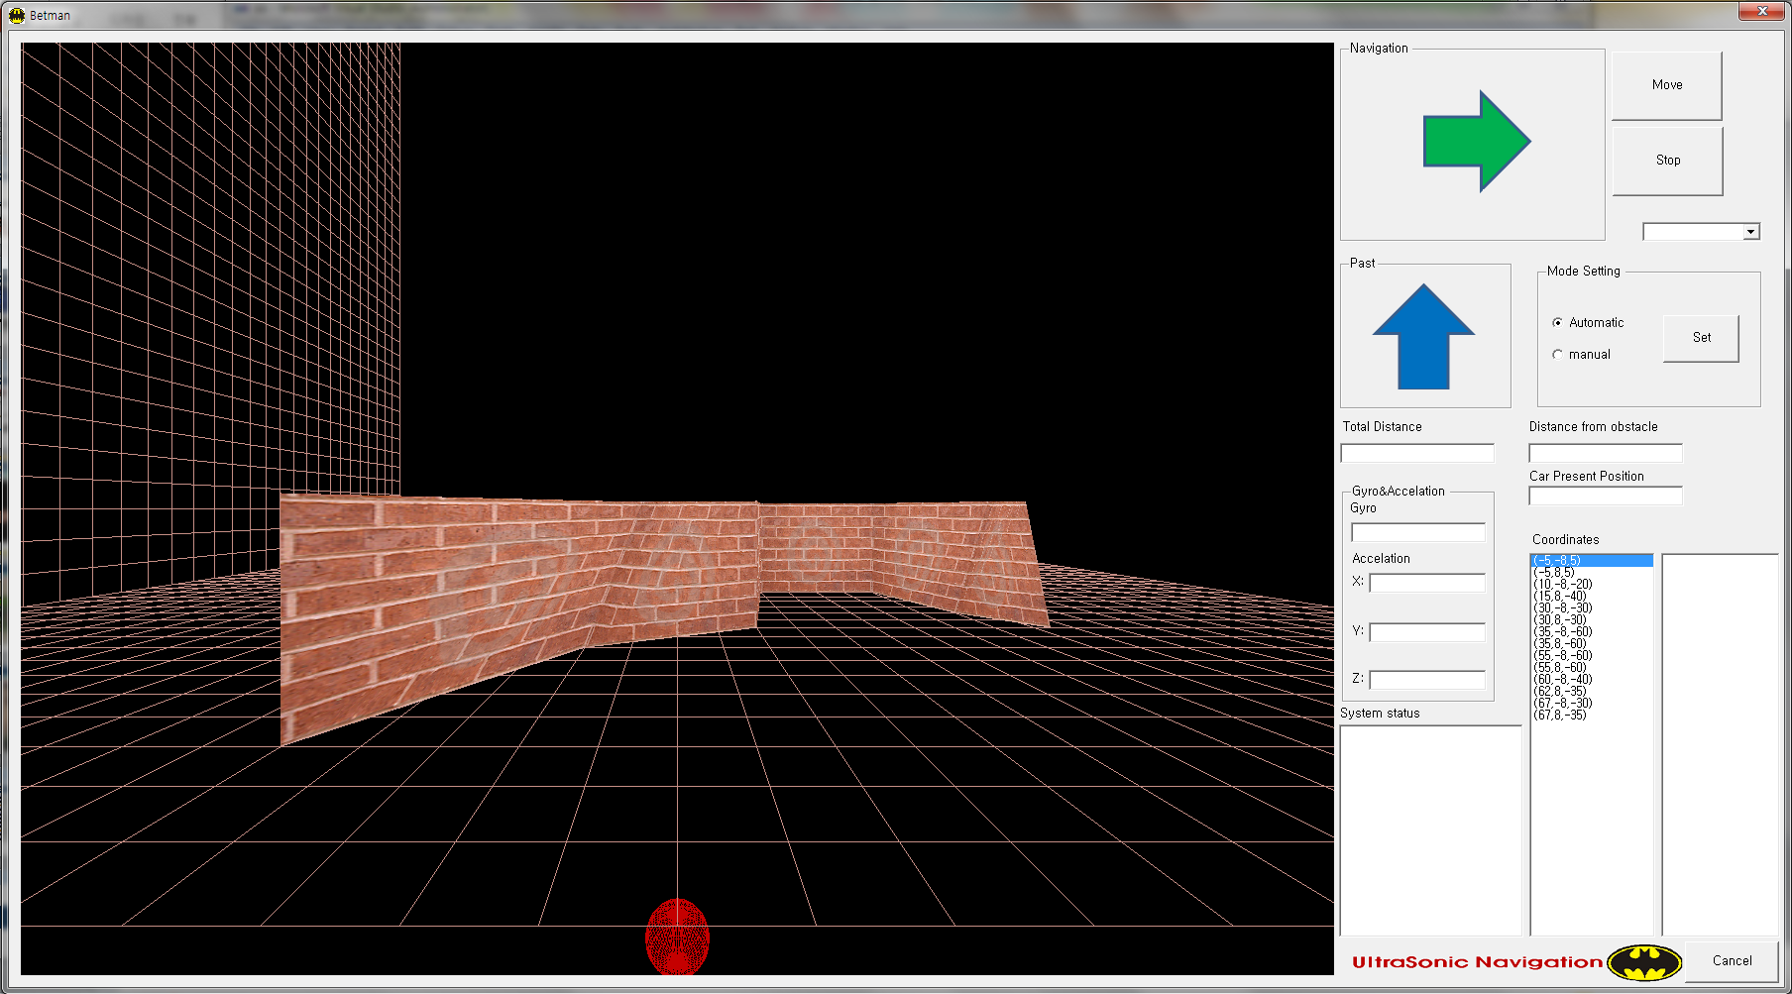
PC Application

Slide 16
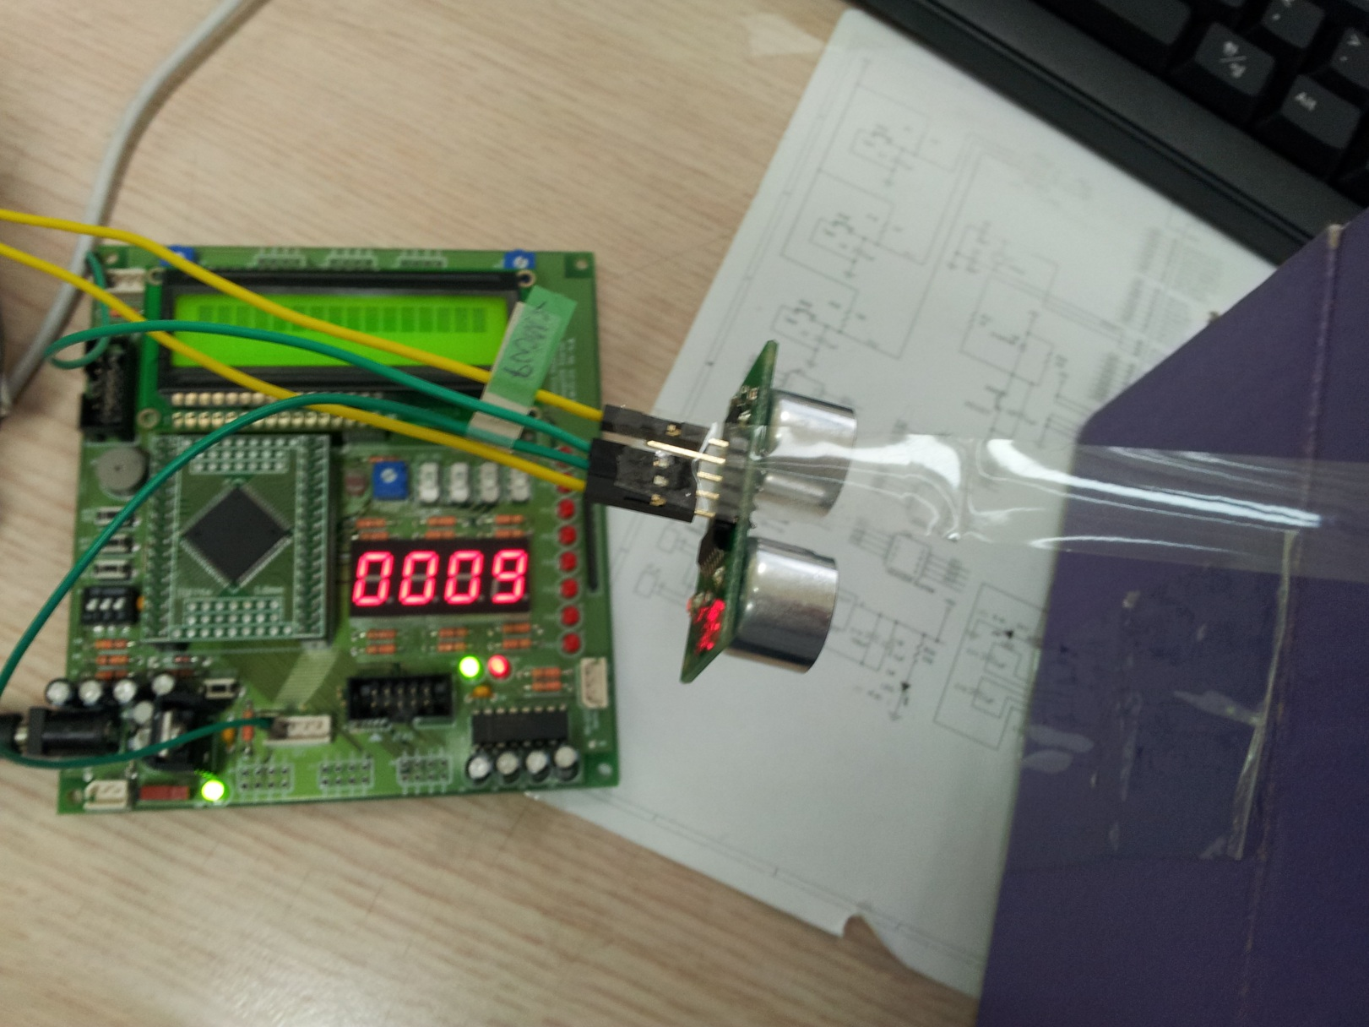
H/W Implementation

Slide 17
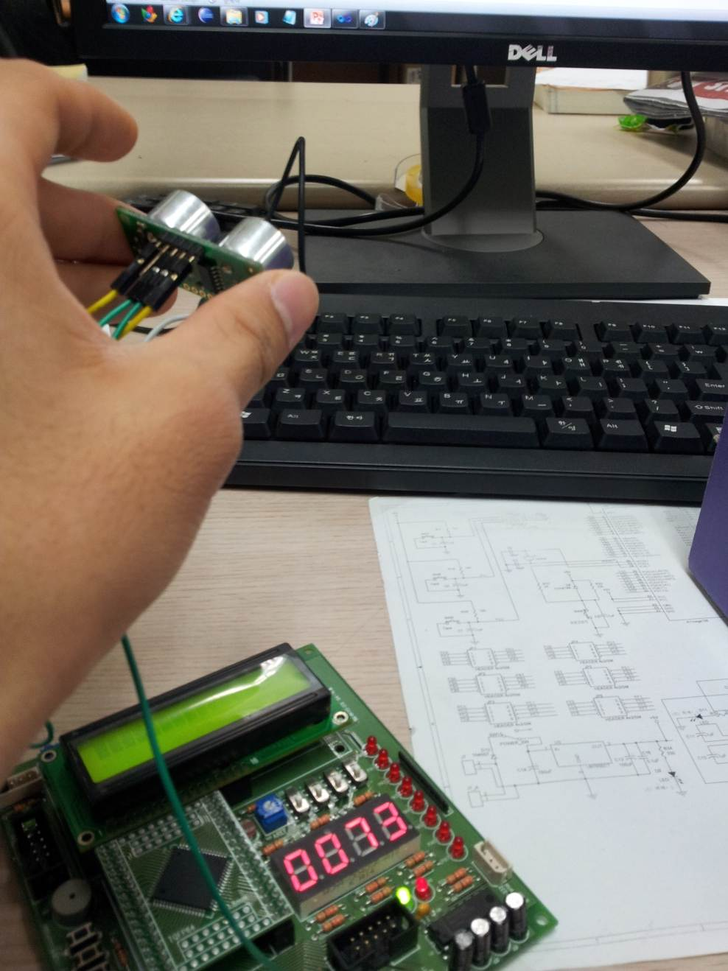
H/W Implementation

Slide 18
Thanks
(- -)(_ _)

